Slide 1
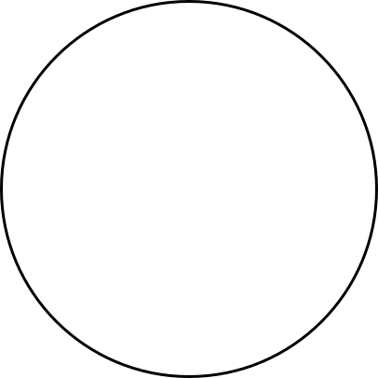
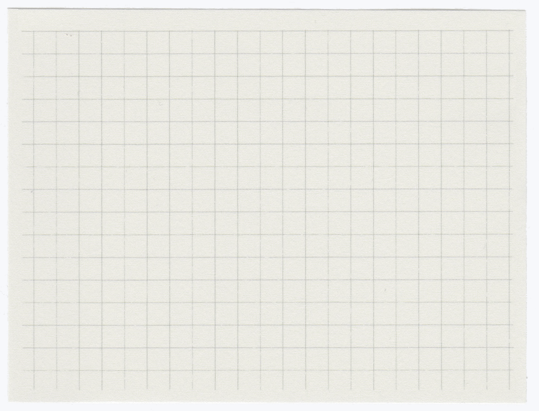

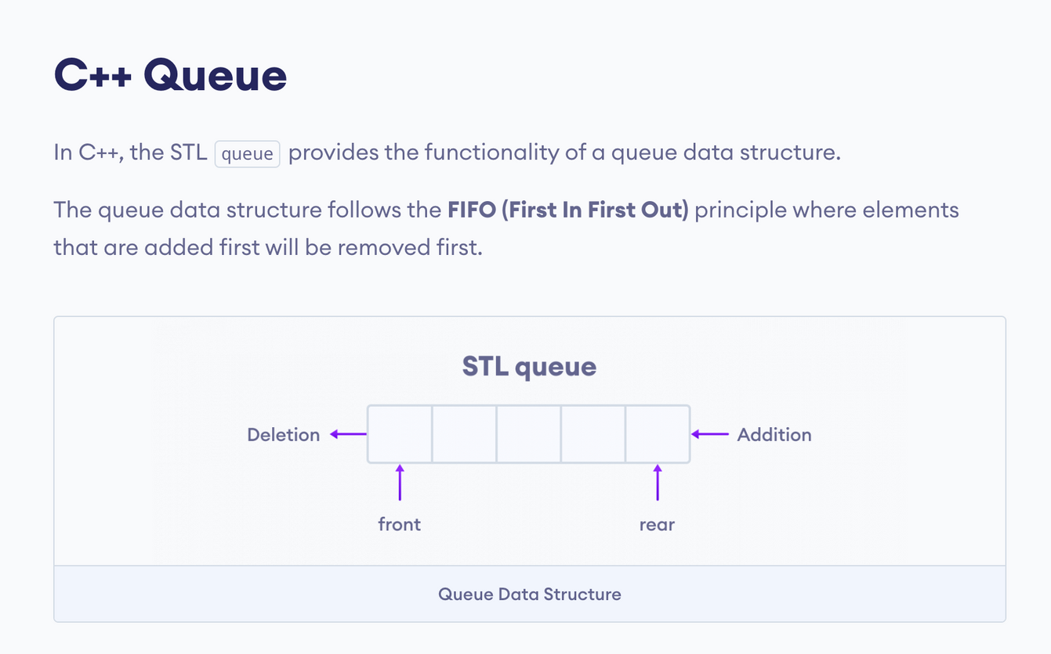
Queue In C++
Presented By: Y Sokha

Slide 2
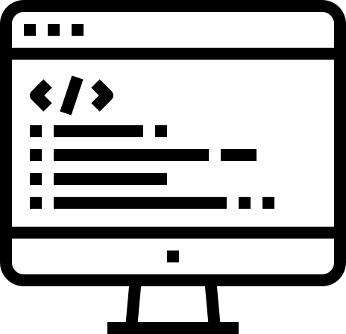
Tables of Contents
Queue Data Structure.
Basic Operations Of Queue.
Working Of Queue.
Enqueue and Dequeue Operations.
Defining and Compiling a Queue class.
Real Life Examples of Queue!

Slide 3
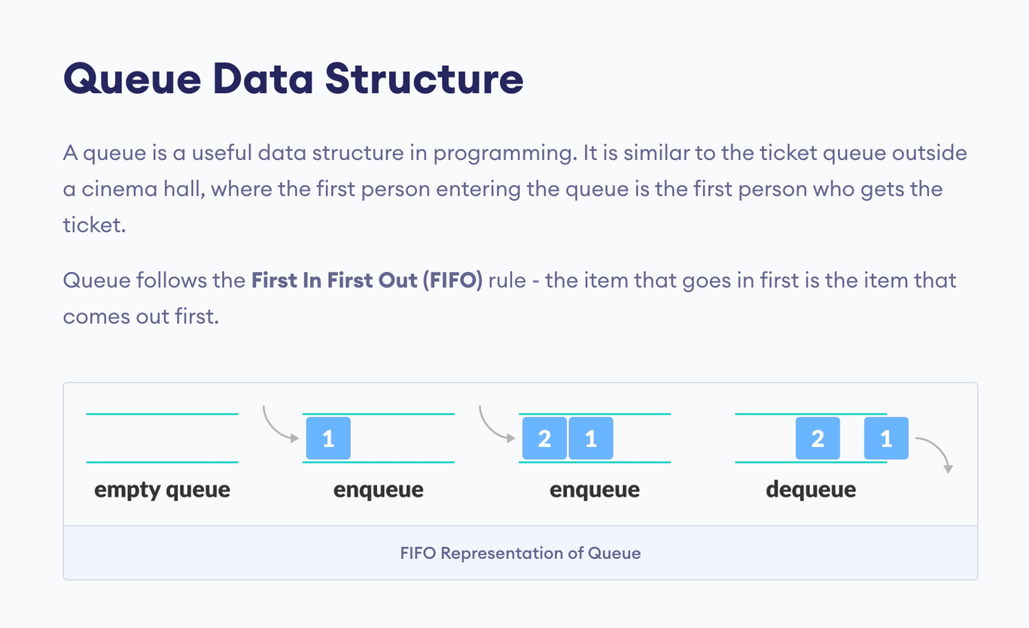
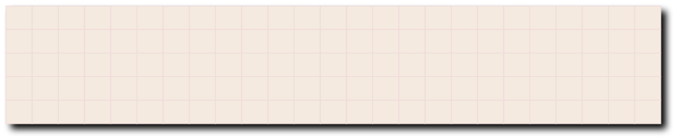
1
In the above image, since 1 was kept in the queue before 2, it is the first to be removed from the queue as well. It follows the FIFO rule.
In programming terms, putting items in the queue is called enqueue, and removing items from the queue is called dequeue.
We can implement the queue in any programming language like C, C++, Java, Python or C#, but the specification is pretty much the same.

Slide 4
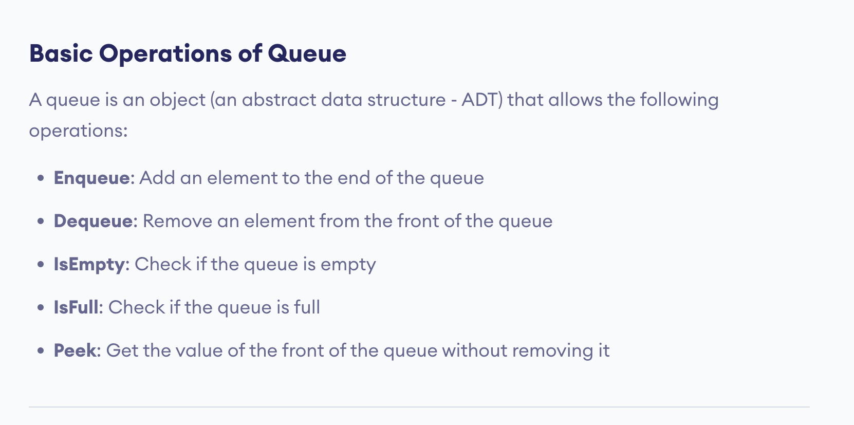
2

Slide 5
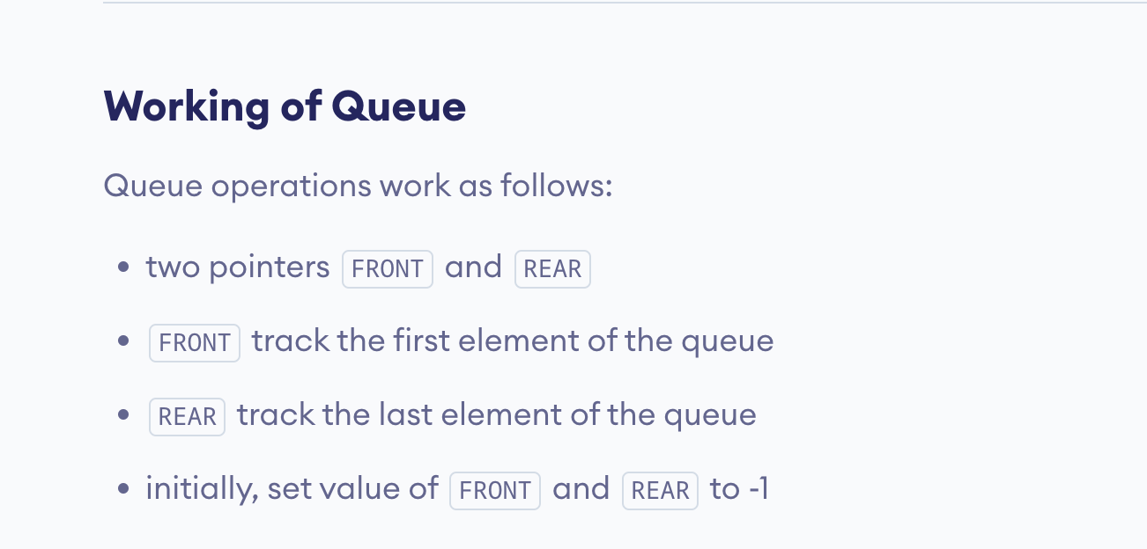
3

Slide 6
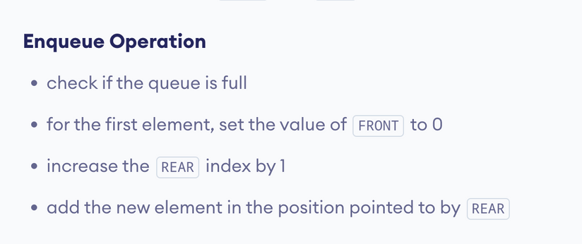

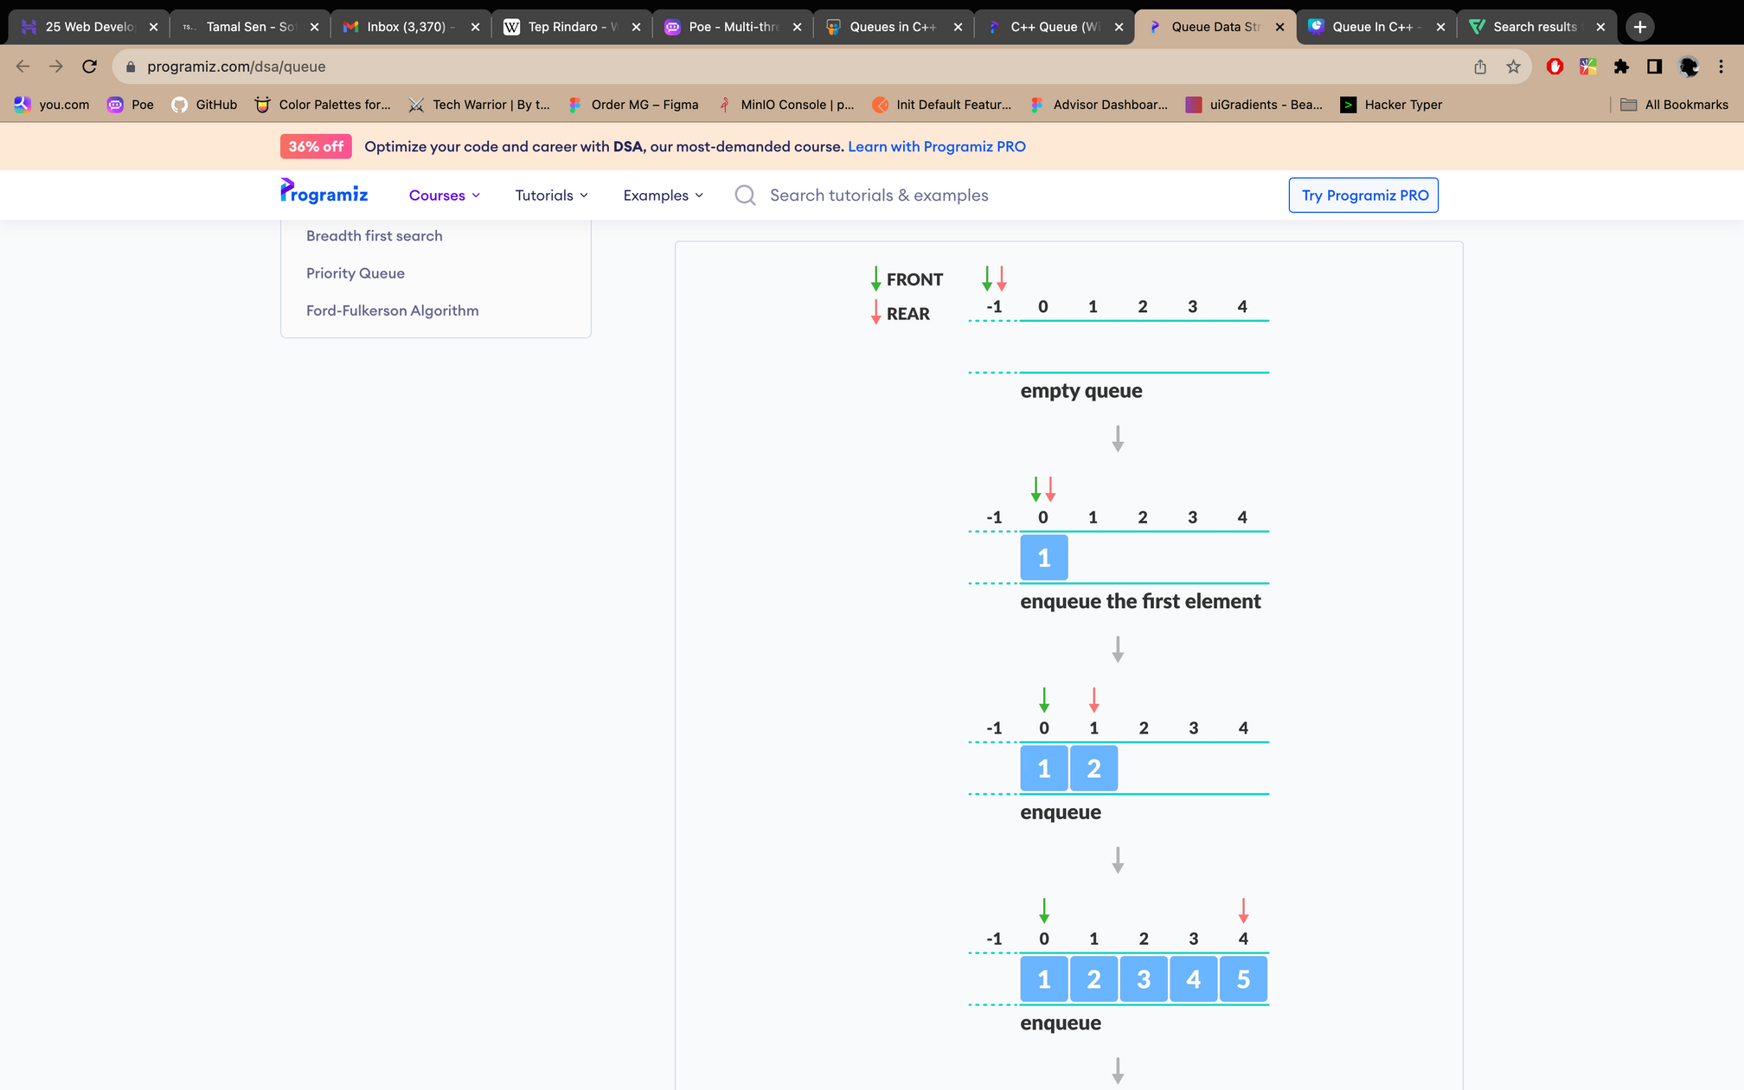
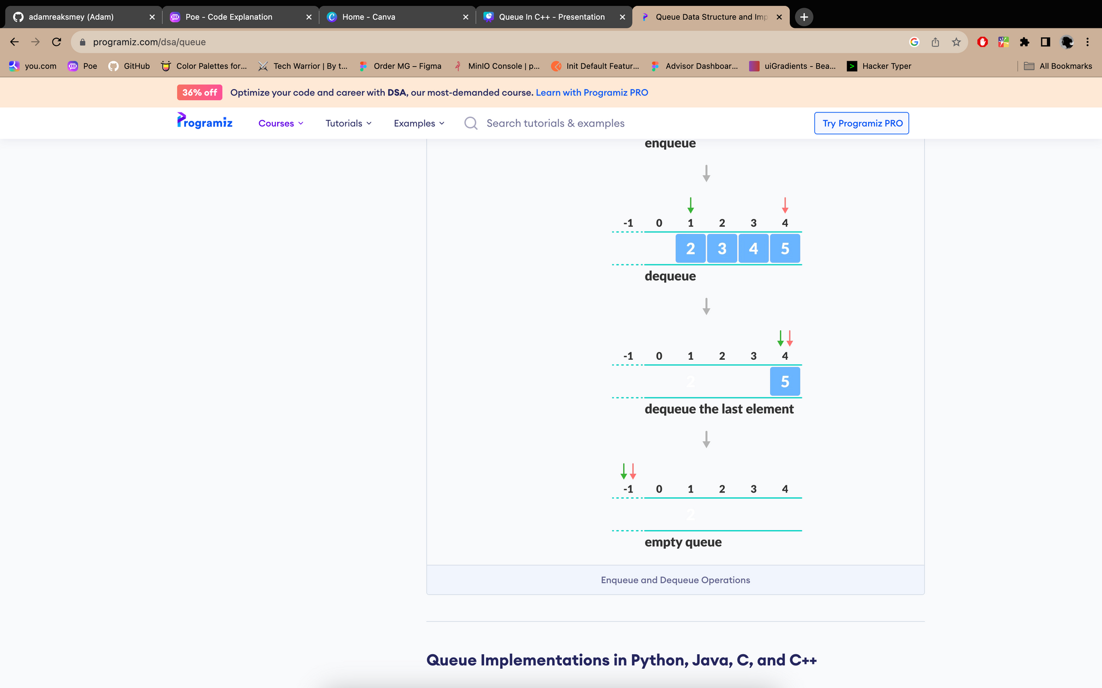
4. Enqueue and Dequeue Operations.
1
2
7
3
6
4
5

Slide 7
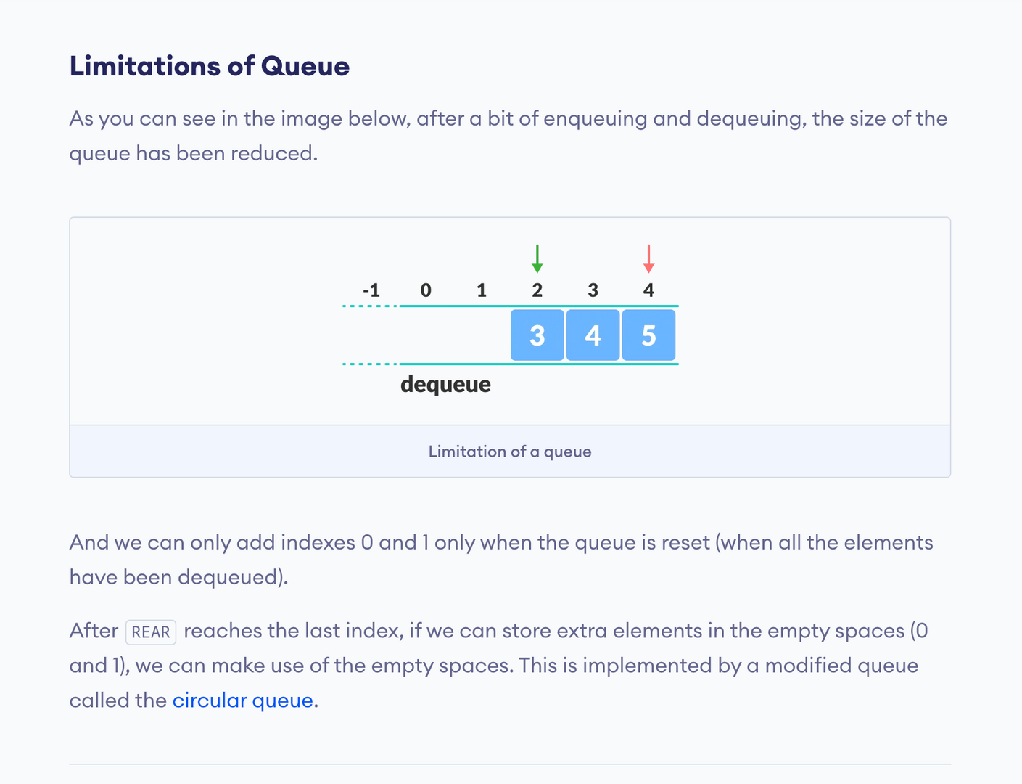

Slide 8
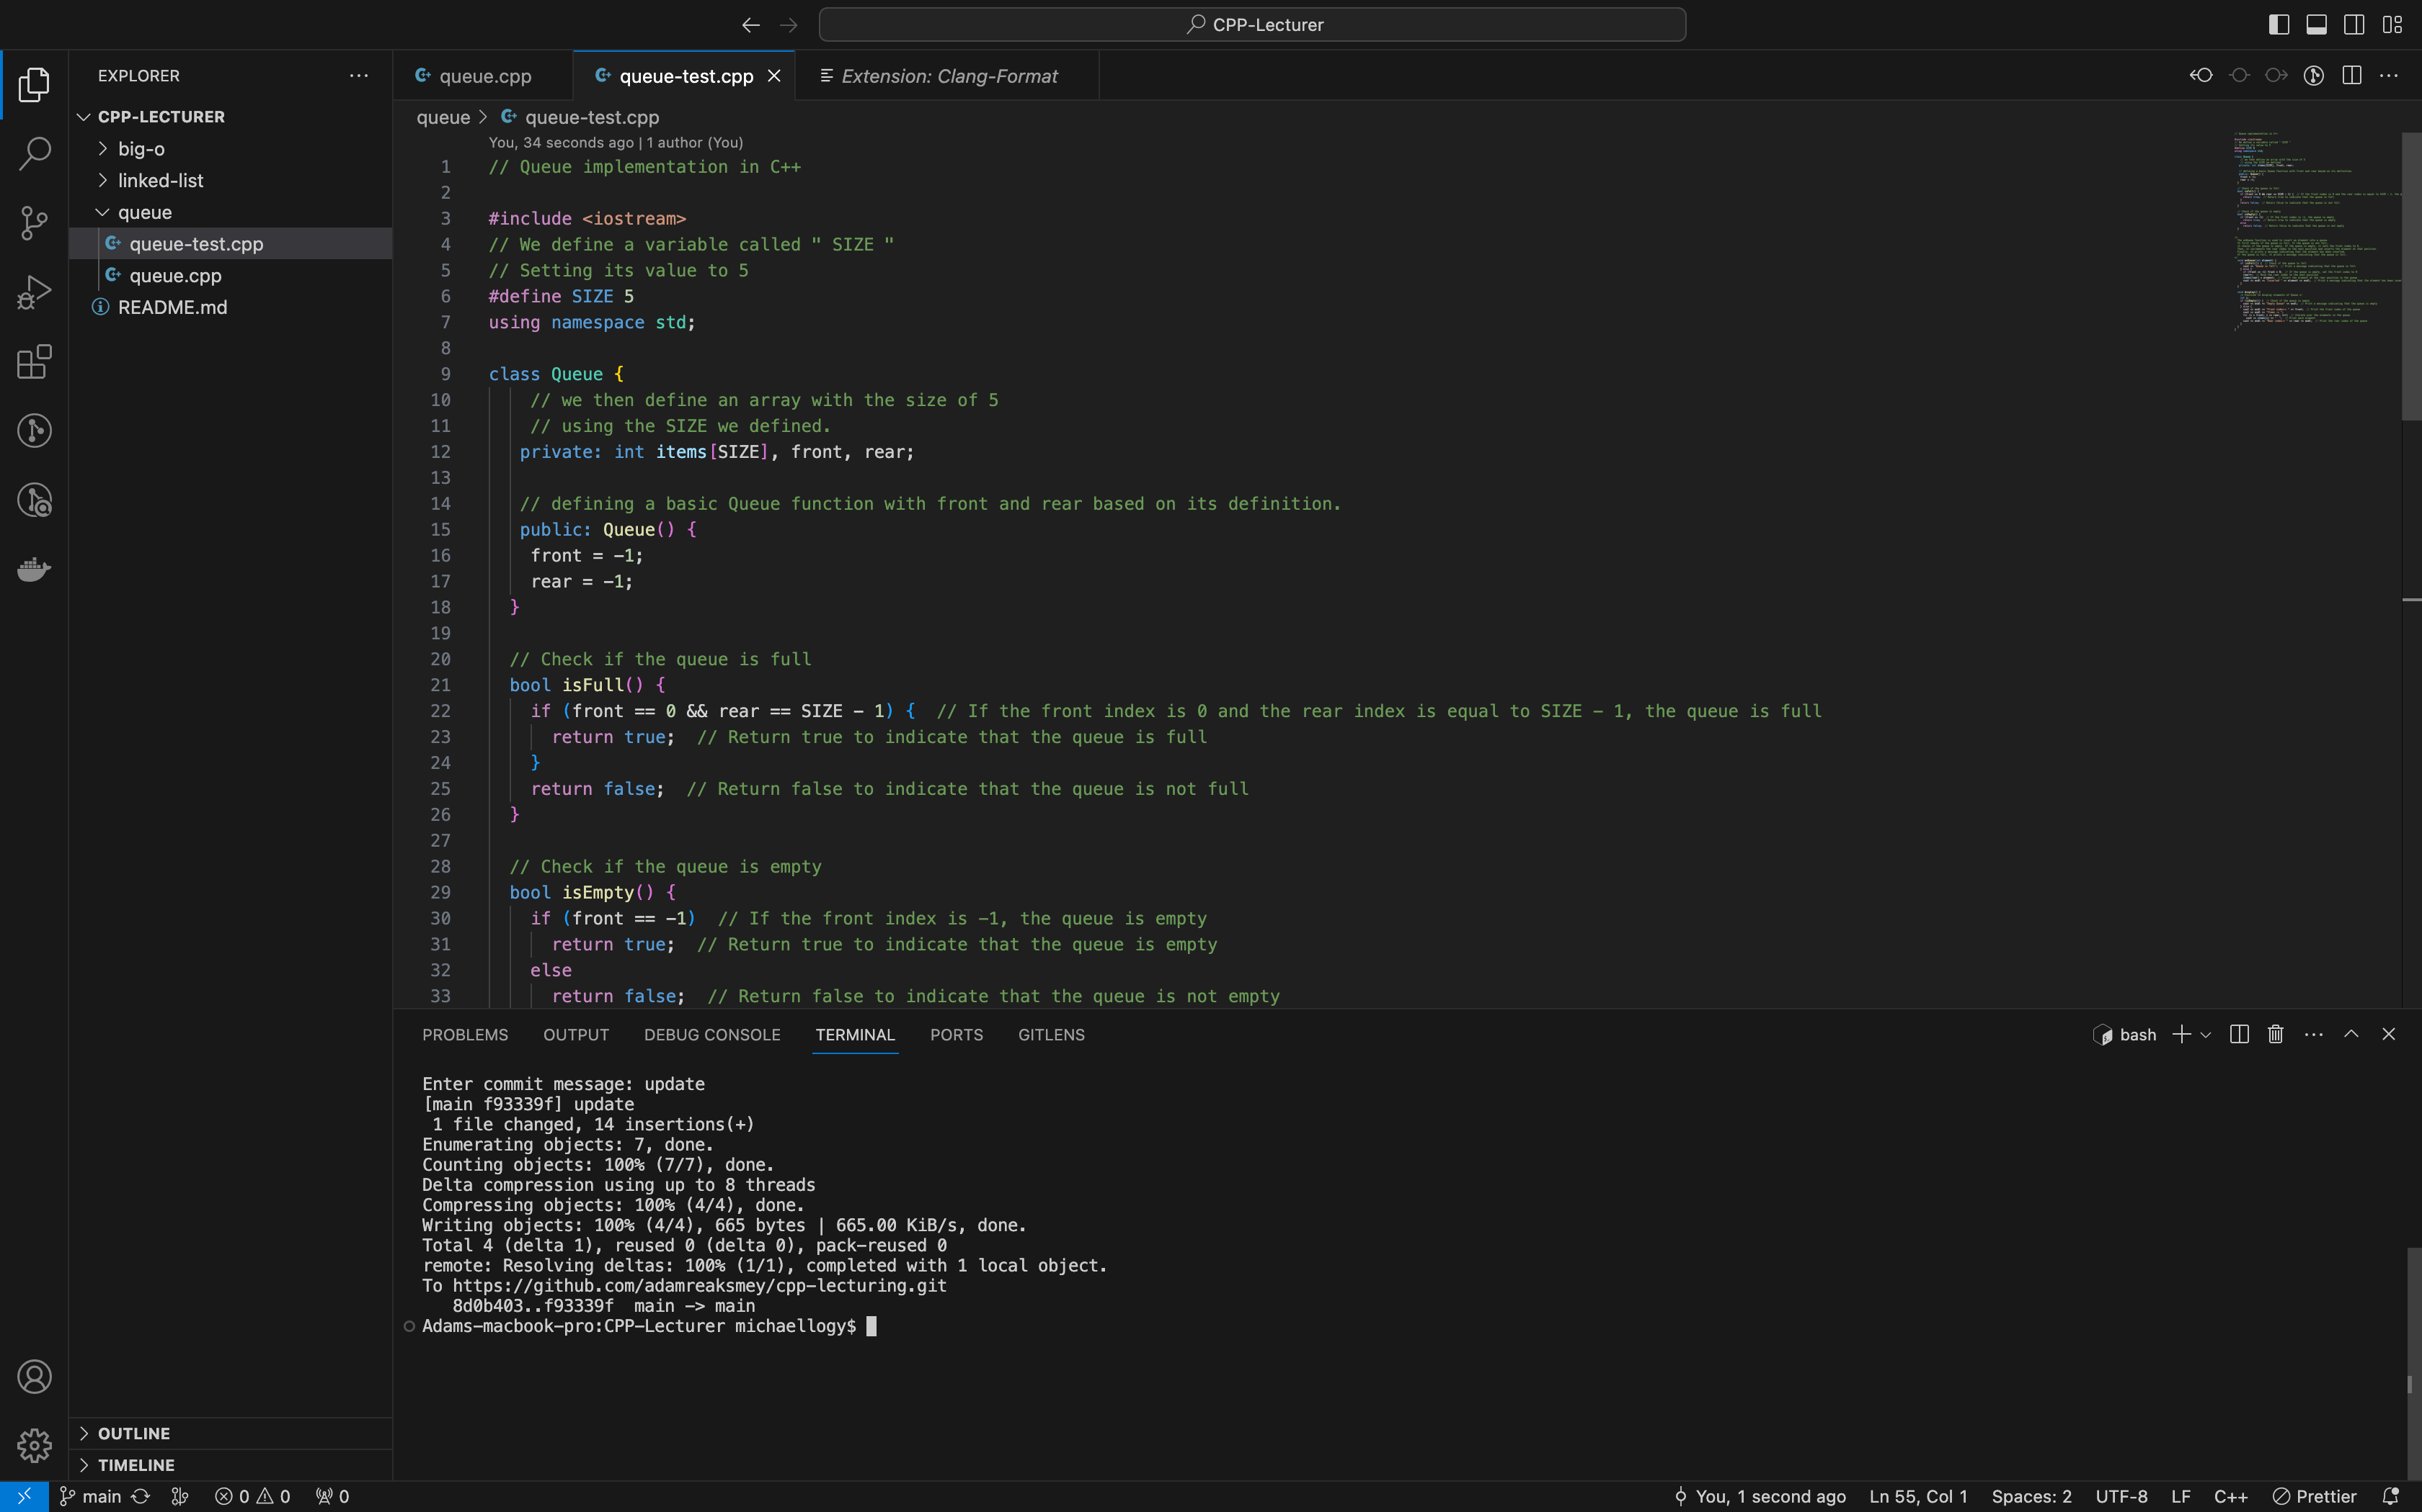
5. Defining and Compiling a Queue class.
...We will be writin every function in the
next slides in this Queue {} class. make sure they
are all in the Class!

Slide 9
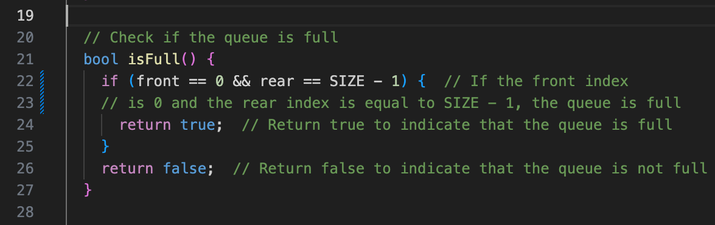
The isFull function is used to check if the queue is full. It does this by checking if the front index is 0 and the rear index is equal to SIZE - 1, where SIZE is the maximum capacity of the queue. If the front index is 0 and the rear index is SIZE - 1, it means that the queue is full, and the function returns true. Otherwise, if the condition is not met, it means that the queue is not full, and the function returns false.

Slide 10
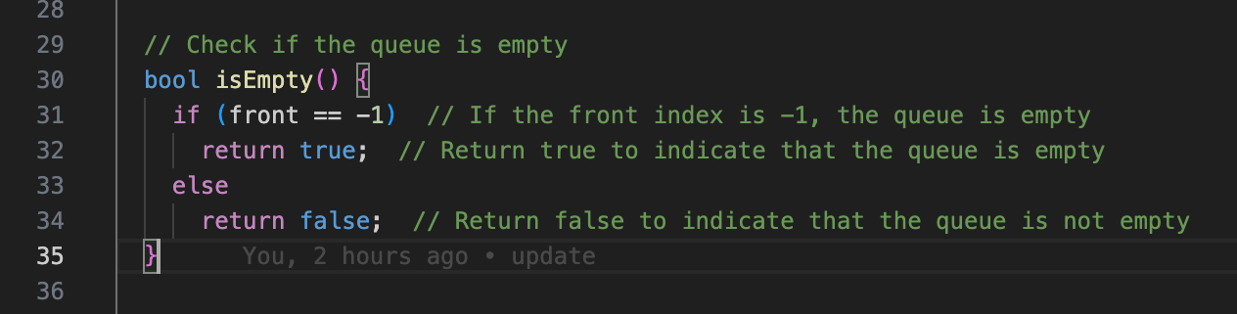
the isEmpty function is used to check if the queue is empty. It does this by checking if the front index of the queue is -1. If the front index is -1, it means that the queue is empty, and the function returns true. Otherwise, if the front index is not -1, it means that the queue is not empty, and the function returns false.

Slide 11
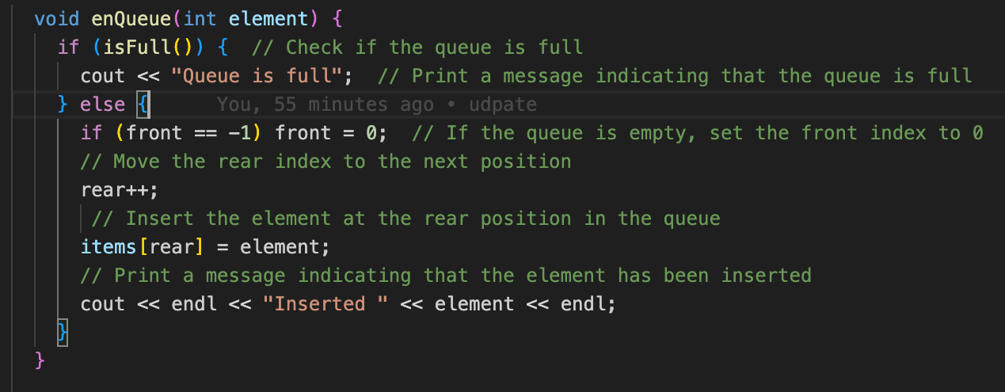
The enQueue function is used to insert an element into a queue. It first checks if the queue is full. If the queue is not full, it checks if the queue is empty. If the queue is empty, it sets the front index to 0. Then, it increments the rear index to the next position and inserts the element at that position. Finally, it prints a message indicating that the element has been inserted. If the queue is full, it prints a message indicating that the queue is full.

Slide 12
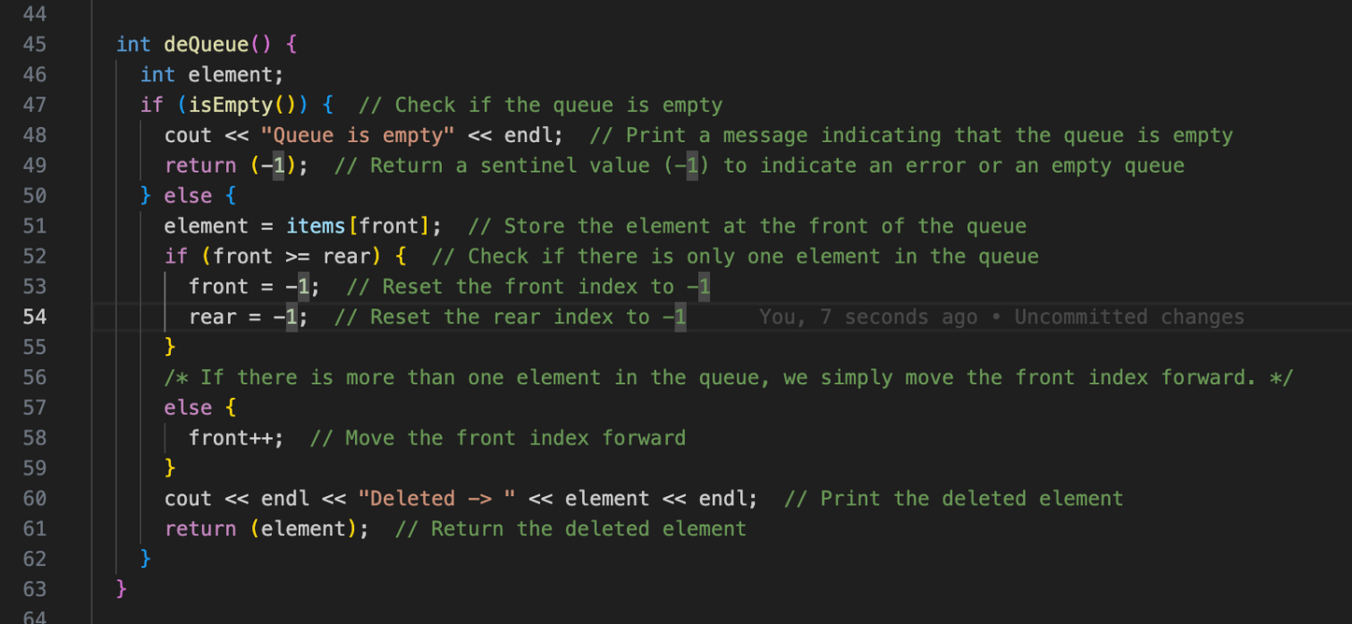
The deQueue function is used to remove an element from the front of the queue. If the queue is empty, it prints a message indicating that the queue is empty and returns a sentinel value (-1) to indicate an error or an empty queue. Otherwise, it retrieves the element at the front of the queue, updates the front index accordingly, and prints the deleted element. If there was only one element in the queue, the front and rear indices are reset to -1 to indicate an empty queue after deletion.

Slide 13
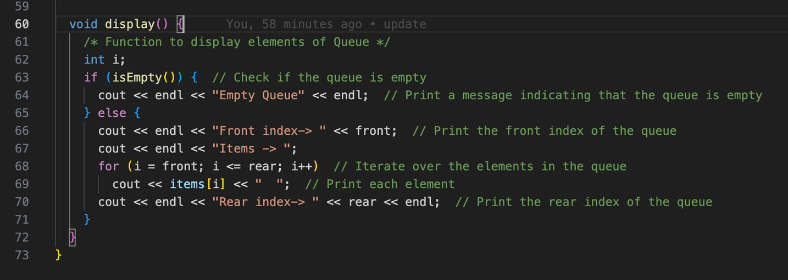
close our Queue class!
And finally, At the bottom and last of our class, we have the display function which is used to display the elements of the queue. If the queue is empty, it prints a message indicating that the queue is empty. Otherwise, it prints the front index of the queue, followed by the elements in the queue, separated by spaces. Finally, it prints the rear index of the queue.
Make sure all of the previous functions stay in the Queue class!

Slide 14
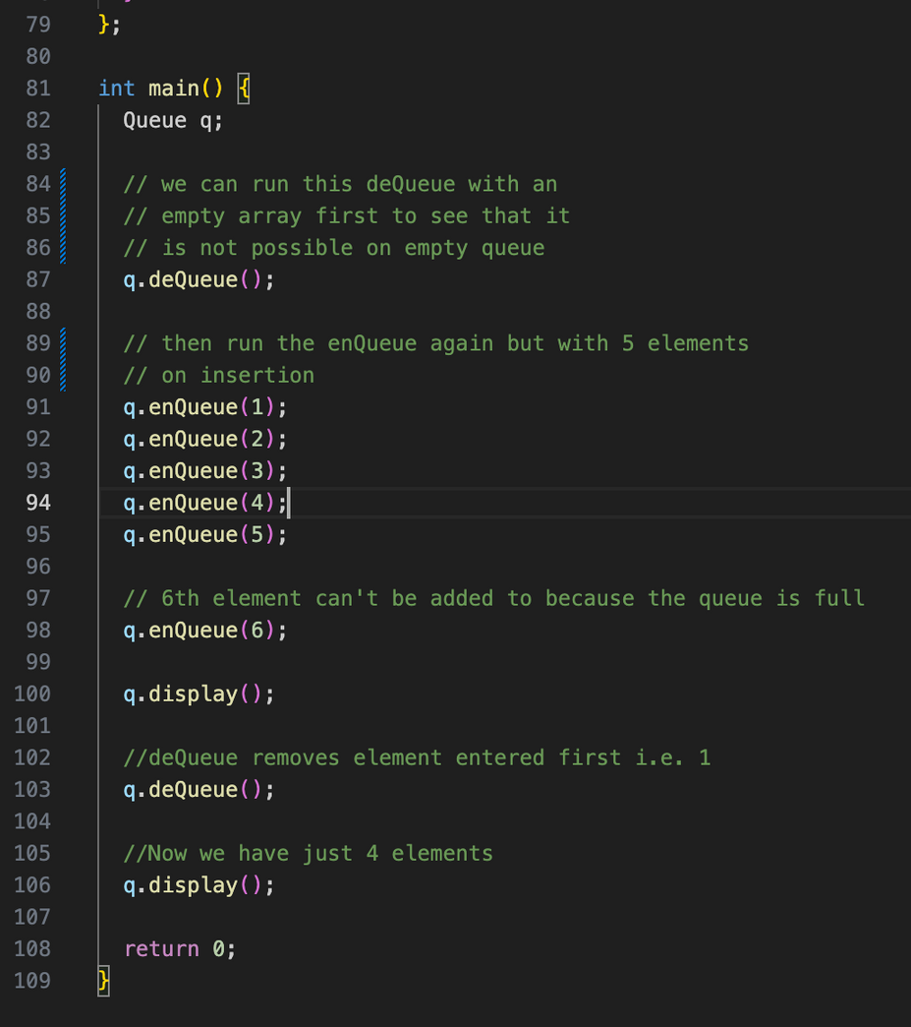
Now we compile to see the magic!
Broken down by Adam.

Slide 15
Here is our first function compiled:
“ Queue is empty ”
Broken down by Adam.

Slide 16

The 2 part will give you each successful message when an insertion is completed.
Inserted 1
Inserted 2
Inserted 3
Inserted 4
Inserted 5
Broken down by Adam.

Slide 17
This, again, is due to how we defined the variable with the size of 5.
“ Queue is full “
Broken down by Adam.

Slide 18
This function displayed the Queue after all of the elements we added.
“ Front index-> 0 “
“ Items -> 1 2 3 4 5 “
“ Rear index -> 4 “
Broken down by Adam.

Slide 19
Let’s remove an element by dequeueing!
The index “ 1 “ is shown to the removed because it was added first.
“ Deleted -> 1 “
Broken down by Adam.

Slide 20
Now after we dequeue the first element added ( which was 1 ), we can call the display function again to see what does it look like now after having 1 is removed.
“ Front index-> 1 “
“ Items -> 2 3 4 5 “
“ Rear index -> 4 “
Broken down by Adam.

Slide 21
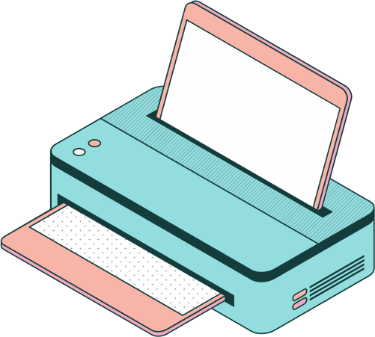
6. Real Life Examples of Queue!
Printer:
When multiple jobs are sent to a printer, they are typically placed in a queue. The printer processes the jobs one by one in the order they were received, ensuring fairness and preventing conflicts.

Slide 22

Call Centers:
In call centers or customer support systems, incoming calls are typically placed in a queue until an agent is available to handle them. This ensures that calls are processed in the order they were received, maintaining fairness and efficient utilization of resources.

Slide 23

Supermarket Checkout:
In a supermarket, customers form a queue at the checkout counters. The first customer in the line gets served first, followed by the subsequent customers. The queue ensures a fair and orderly process for customers to complete their transactions.

